Slide 1

Student Depression Analysis
Muhammad jahanzaib khan​

Slide 2


Agenda
Problem Definition & Objectives​
Asking the Questions​
Data Wrangling (Preprocessing)​
Exploratory Data Analysis (EDA)​
Predictive Analysis

Slide 3



Problem Statement
Identify the factors contributing to depression among students and predict whether a student is likely to experience depression based on various attributes such as academic pressure, sleep duration, financial stress, dietary habits, and family history of mental illness​

Slide 4
Objectives
Determine the key factors influencing depression among students.​
Develop a predictive model to classify students at risk of depression.​

Slide 5
Asking the Questions
Which factors (e.g., academic pressure, financial stress, sleep duration) are most strongly associated with depression?
Can a machine learning model accurately predict the likelihood of depression?
How do demographic variables like age, gender, and city impact depression?.​

Slide 6
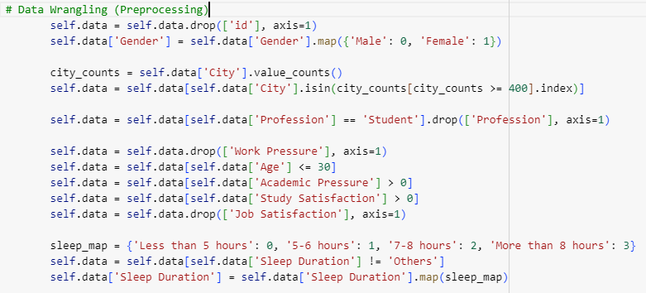
Data Wrangling (Preprocessing)

Slide 7

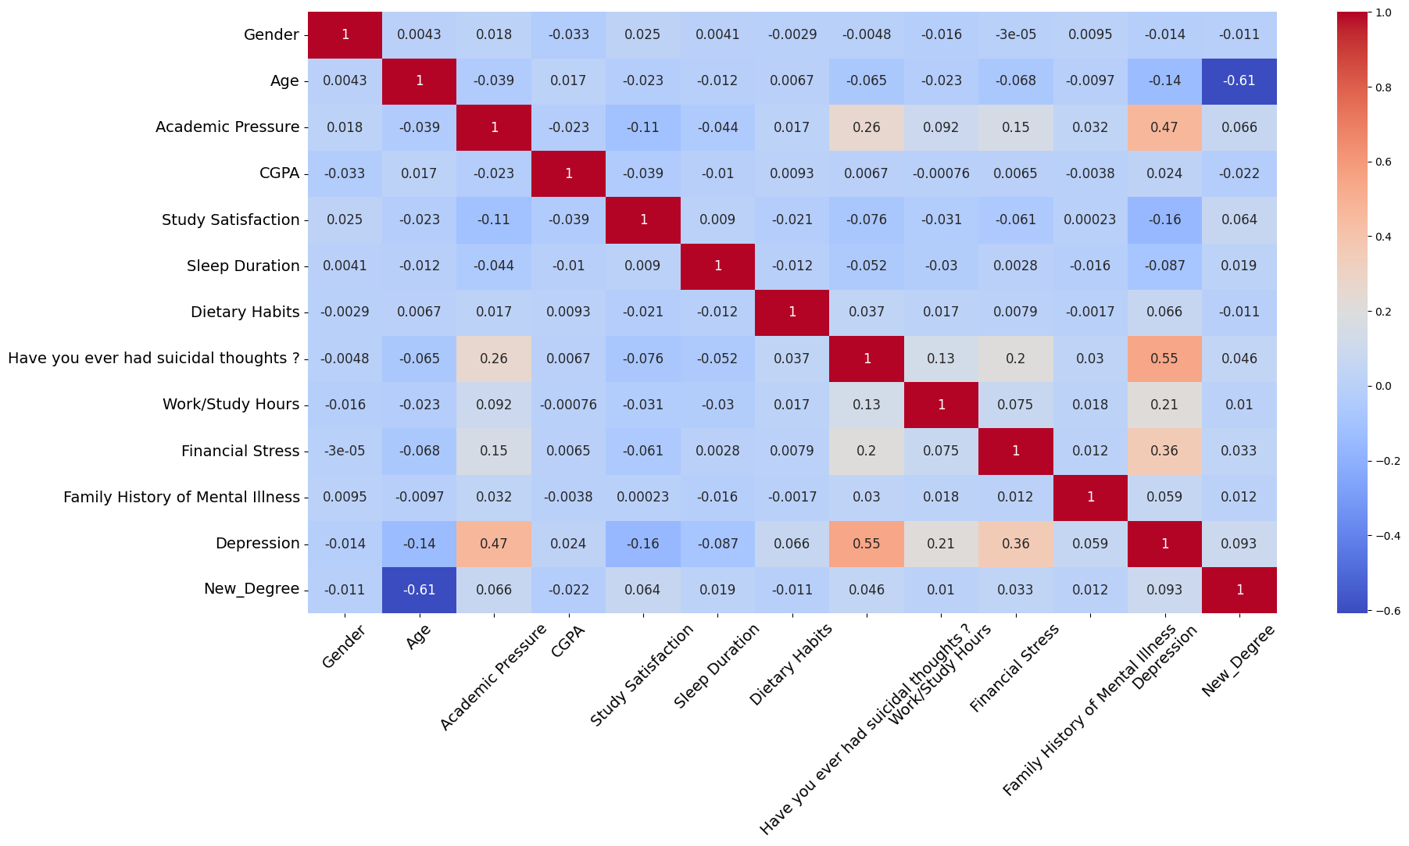
Perform exploratory data analysis (EDA) using correlation matrice and heatmap
Disney

Slide 8
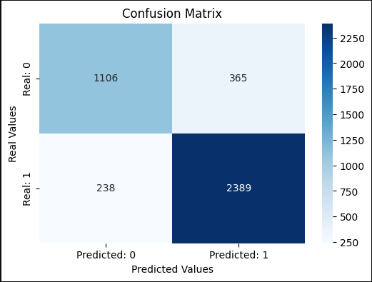
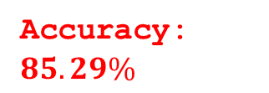
Confusion matrix of single trained classifier
Accuracy: $85.29\%$

Slide 9
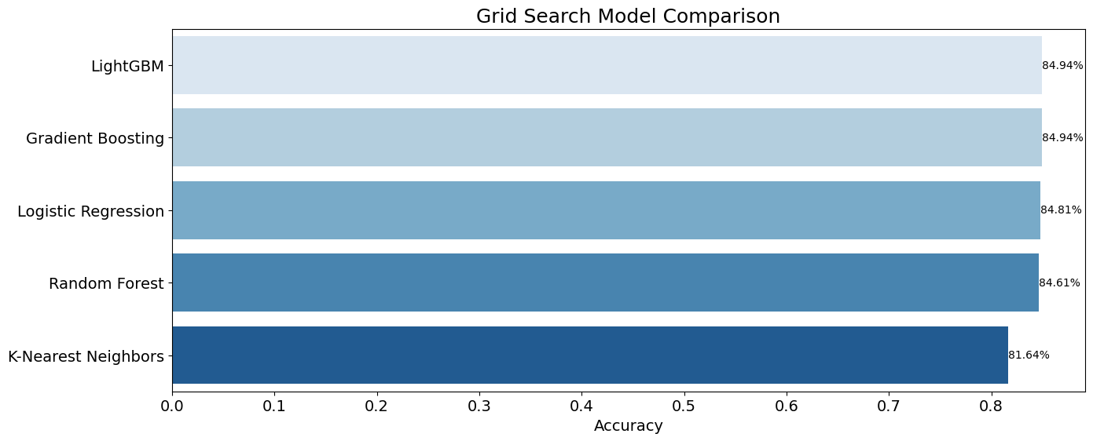
Grid Search Model Comparison

Slide 10
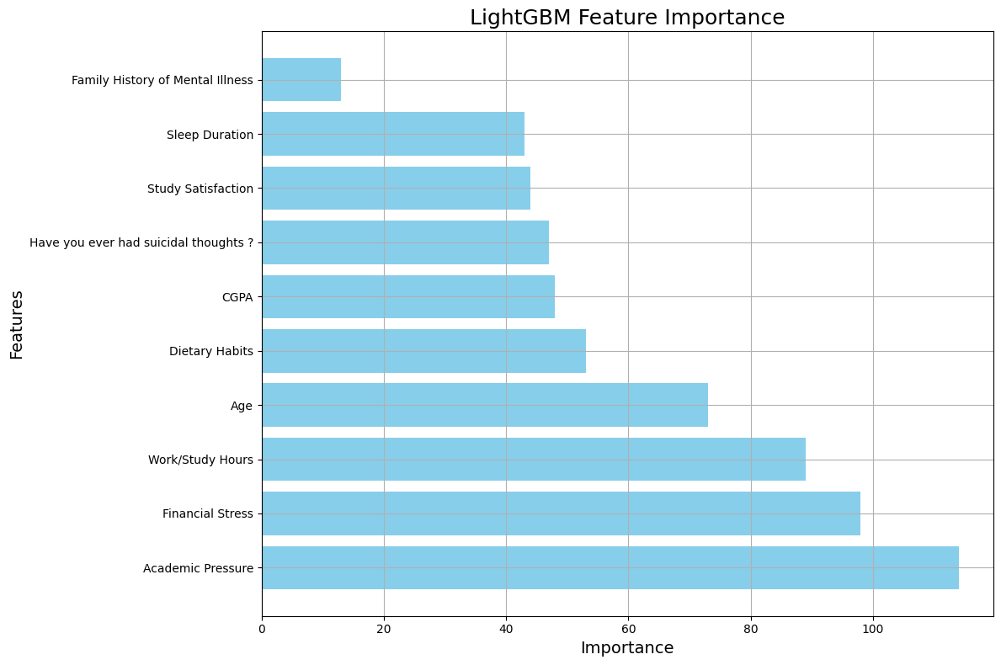

LightGBM Feature Importance
LightGBM Accuracy: 85.$36\%$
1. Academic Pressure: 114.000000
2. Financial Stress: 98.000000
3. Work/Study Hours: 89.000000
4. Age: 73.000000
5. Dietary Habits: 53.000000
6. CGPA: 48.000000
7. Have you ever had suicidal thoughts ?:
47.000000
8. Study Satisfaction: 44.000000
9. Sleep Duration: 43.000000
10.Family History of Mental Illness:
13.000000

Slide 11
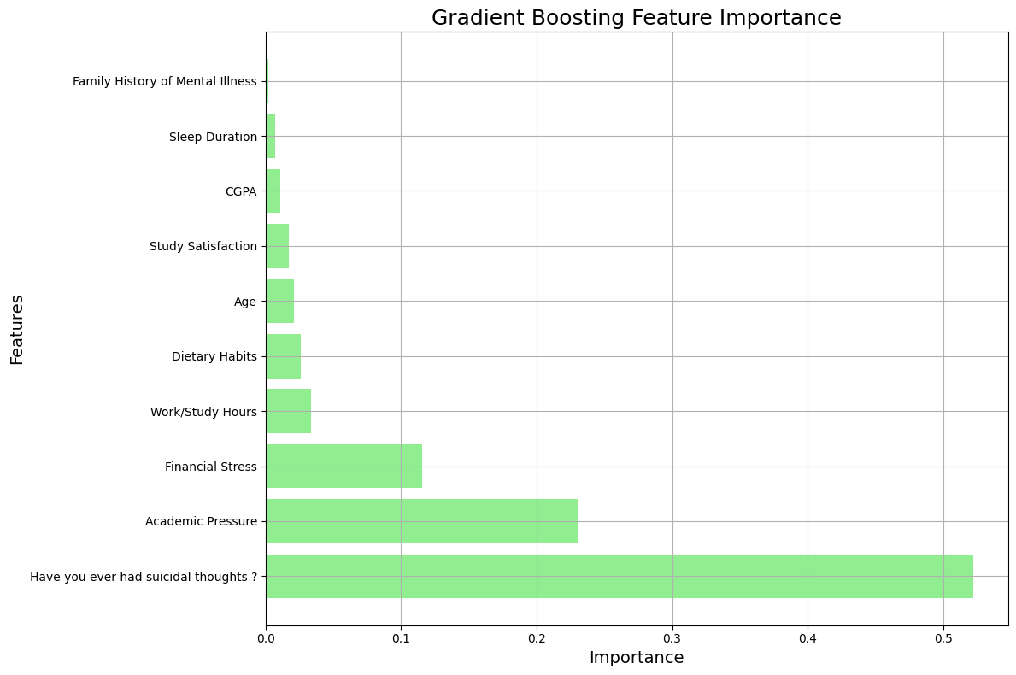
Gradient Boosting Feature Importance
Gradient Boosting Accuracy: 85.$33\%$
Have you ever had suicidal thoughts ?:
0.521981
2. Academic Pressure: 0.230845
3. Financial Stress: 0.115713
4. Work/Study Hours: 0.033874
5. Dietary Habits: 0.026013
6. Age: 0.020854
7. Study Satisfaction: 0.017150
8. CGPA: 0.011101
9. Sleep Duration: 0.007390
10. Family History of Mental Illness: 0.002002

Slide 12

Thank You

